Slide 2
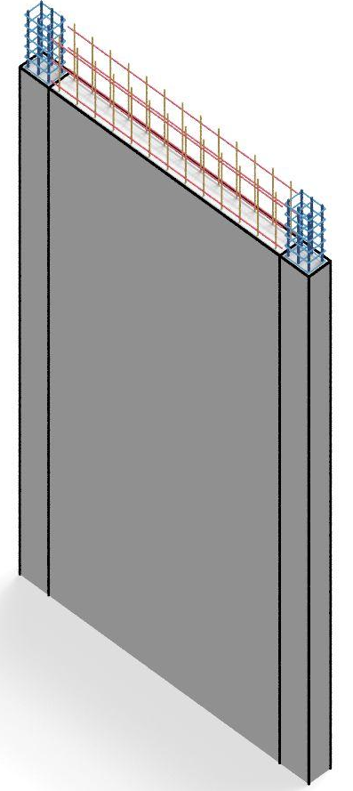
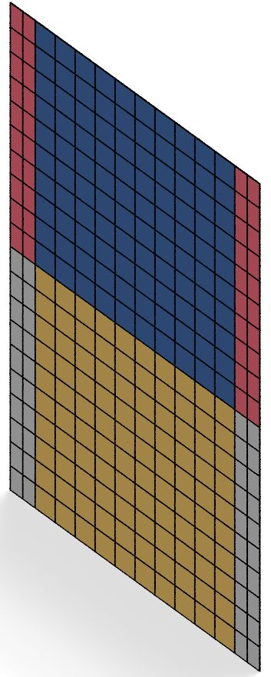

workflow
Model
quality
BIM
SAM
c++
Simulation
analysis
TclCreator
Python
Python, c++
encoding
decoding
EVT/EDP
Python
BIM features
Neural Net
SAM features

Slide 3

Rebuilt in Tensorflow using
Keras is a high-level neural networks API, written in Python and capable of running on top of TensorFlow, CNTK, or Theano.
Python
BIM feature
Neural Net
SAM feature

Slide 4
Continuum model: C++
Beam-column model: Python
Python call:
Python, c++
decoding
SAM feature
Done

Slide 5
SAM
c++
Simulation
analysis
TclCreator
Done

Slide 6
NeuralNet V1
Inputs:
{[height, length, thickness, E, fc]}
BIM
Outputs: (multi-feature regression)
[Ap,An,Bn,beta,N]
Python
encoding
BIM feature
Done

Slide 7
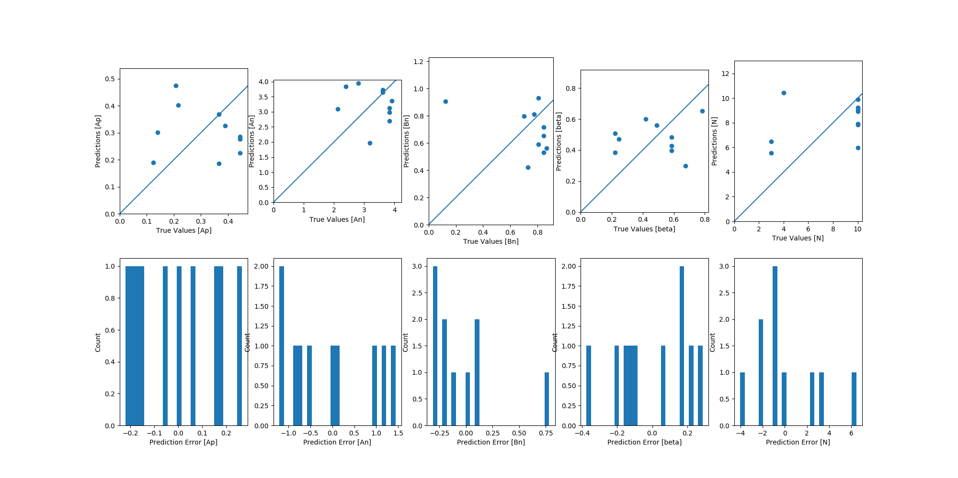
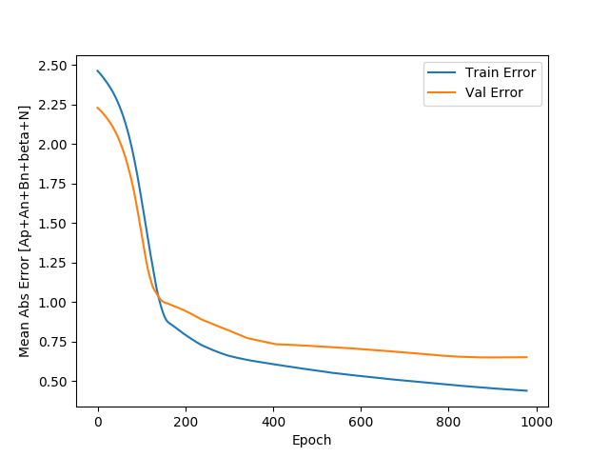
NeuralNet V1
Training
Predictions on test dataset

Slide 8
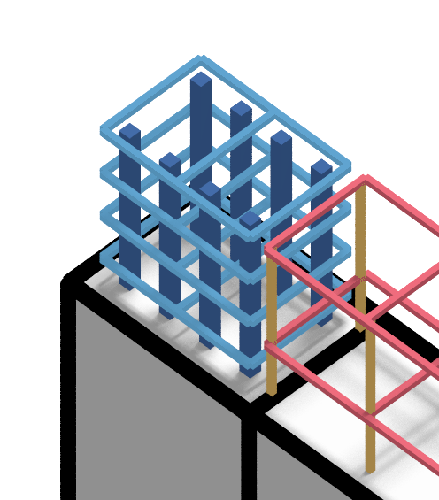
NeuralNet V2
Material varies in different walls.
Mat 1 in wall A could be different from Mat 1 in wall B.
1: concrete
2: steel
Cuboids
BIM
{x,y,z,l,w,h,matId}
Old inputs:
New Inputs:
{x,y,z,l,w,h,matType,matProp1,matProp2,…}
Python
encoding
1: concrete
2: steel
E
fc for concrete
Fy for steel
BIM feature
Done
Outputs: (multi-feature regression)
[Ap,An,Bn,beta,N]

Slide 9
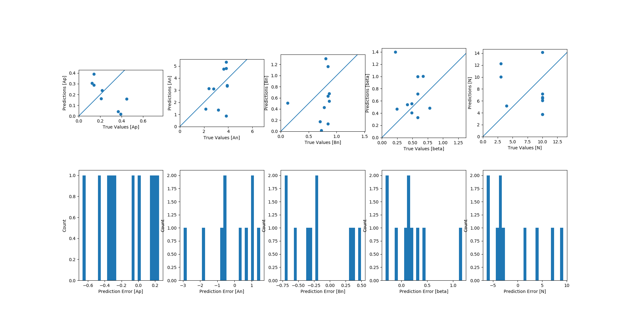
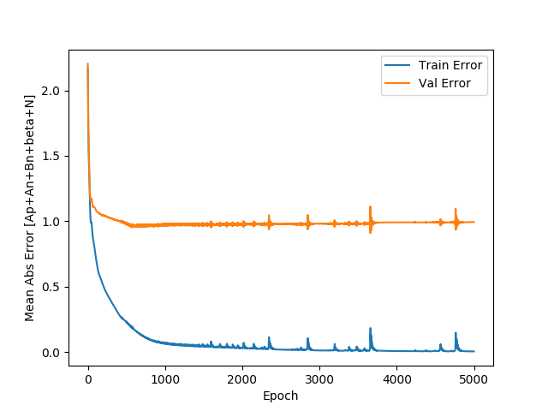
NeuralNet V2
Training
Predictions on test dataset

Slide 11
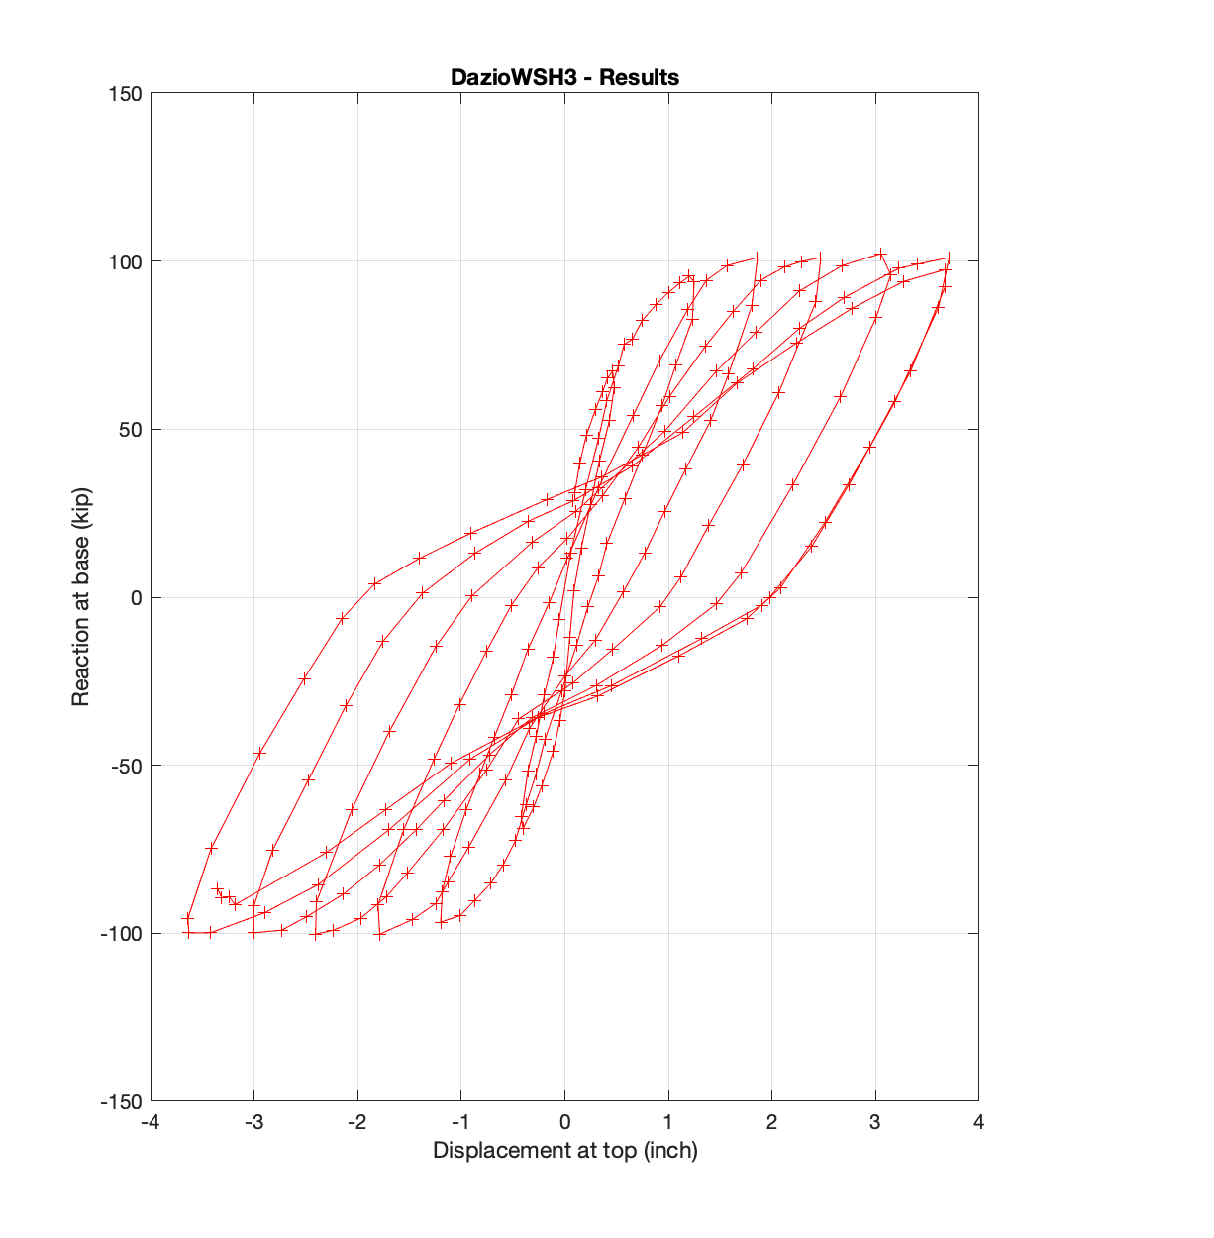
On going: AI based Backbone Curve Prediction
Inputs:
{[height, length, thickness, E, fc]}
Outputs: (multi-feature regression)
[Ap,An,Bn,beta,N]

Slide 12
On going: AI based Backbone Curve Prediction
V_{m}
Inputs:
V_{y}
{[height, length, thickness, E, fc, Other parameters]}
Outputs: (multi-feature regression)
[V_{m}, V_{y}]

